Slide 1
AI for scientific computing and the PNP-BV problem revisited
Jake Weinstein

Slide 2
Live demo

Slide 3
Preface on the PNP-BV Solver

Slide 4
What I’ll cover
The problem – ORR selectivity
Previous work in this area that I’m building on
The model – PNP-BV
Why it’s hard numerically
How this work solves it
Verification – How do we know it’s right
What’s next

Slide 5
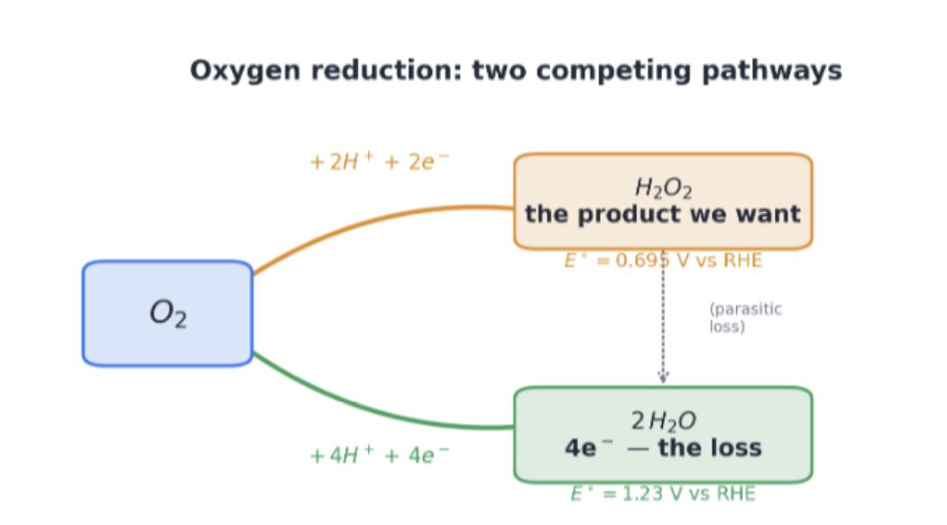
The Problem

Slide 6
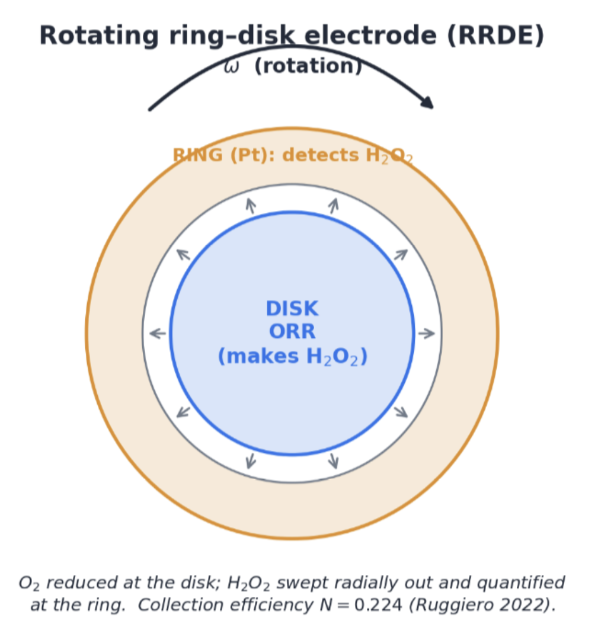
How it’s measured

Slide 7
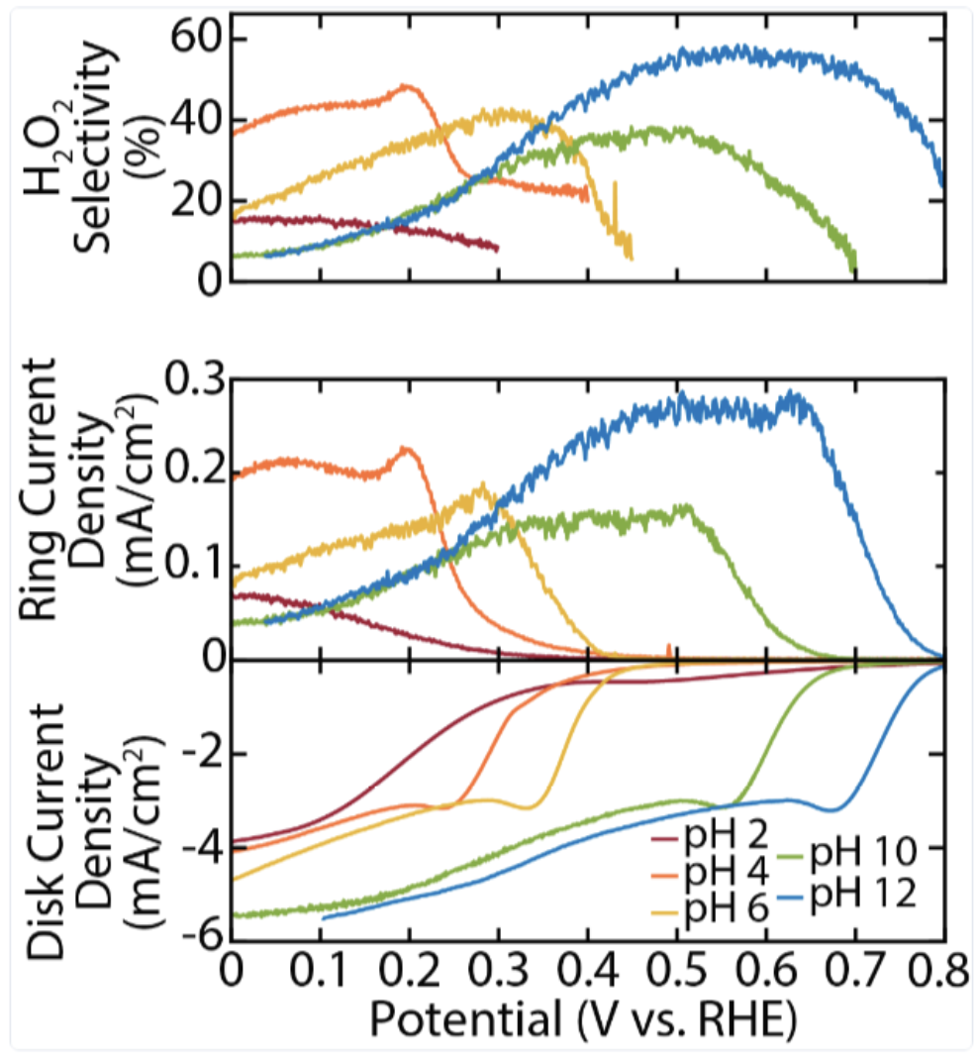
The data we’re trying to explain

Slide 8
The real goal of this
Model selection – Which mechanisms are responsible for the curves?
Parameter inference

Slide 9
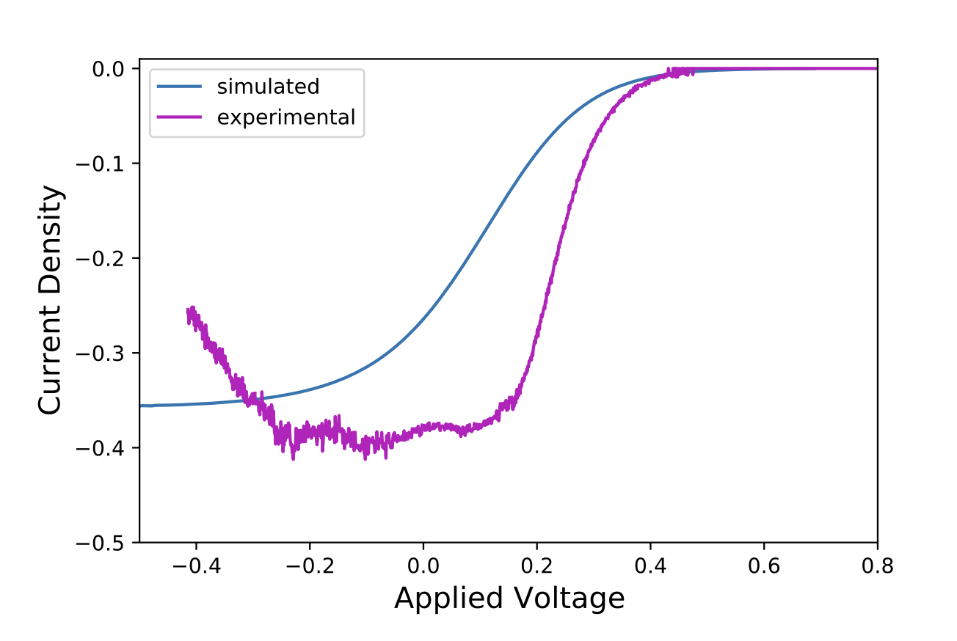
Previous work by Jithin George
No actual PDE solver
Use an analytic closure for concentrations, ODE on the potential
Then solve another equation at the boundary to give Butler-Volmer

Slide 10
Limitations
Only 1 reaction?
Not a true physics solve, so can’t easily extend the model
One or two more here

Slide 11
Now to the full PDE solver

Slide 12
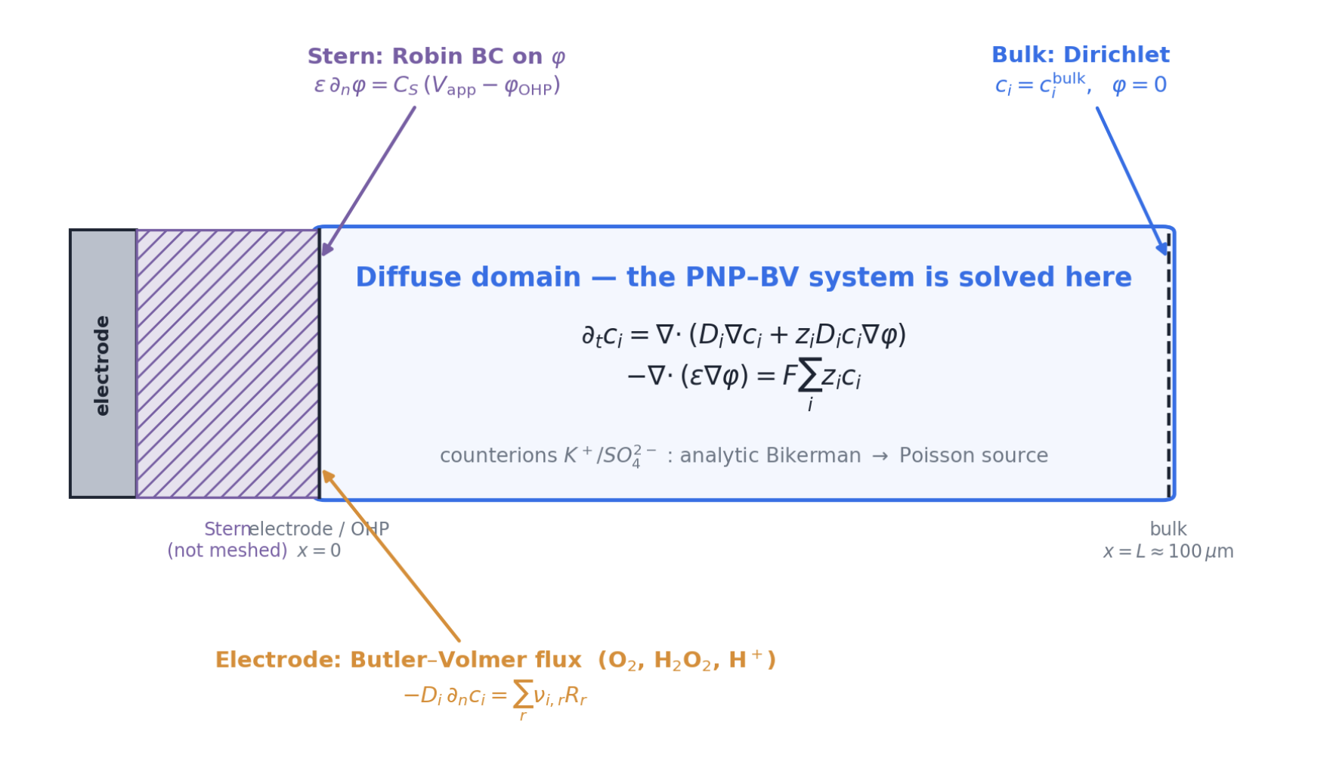
The Model

Slide 13
Why it’s numerically terrible
Concentrations at steady state span 10 orders of magnitude.
The potential varies a lot over a very small domain near the electrode.
Exponential nonlinearity from the BV terms in the boundary causes exponential concentration buildups and potentials.
Electromigration and natural diffusion run on very different timescales

Slide 14
How do we solve this
Model u=ln(c), not c
Enforces non-negative concentration and deals with exponential concentration buildups.
For H+, model μ = ln(c) + φ
Log-rate BV – Add eqs here
Analytic non-reactive ions
Continuation

Slide 15
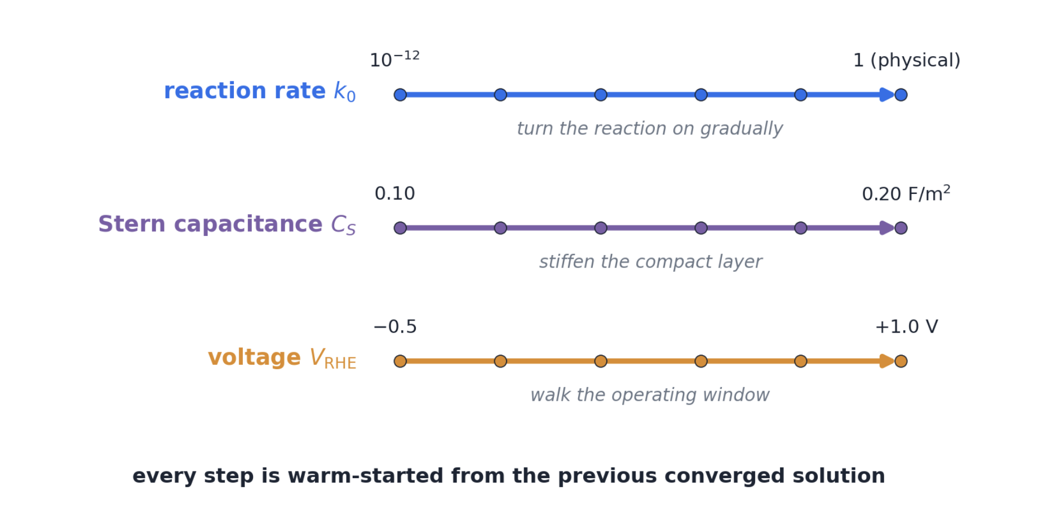
Continuation

Slide 16
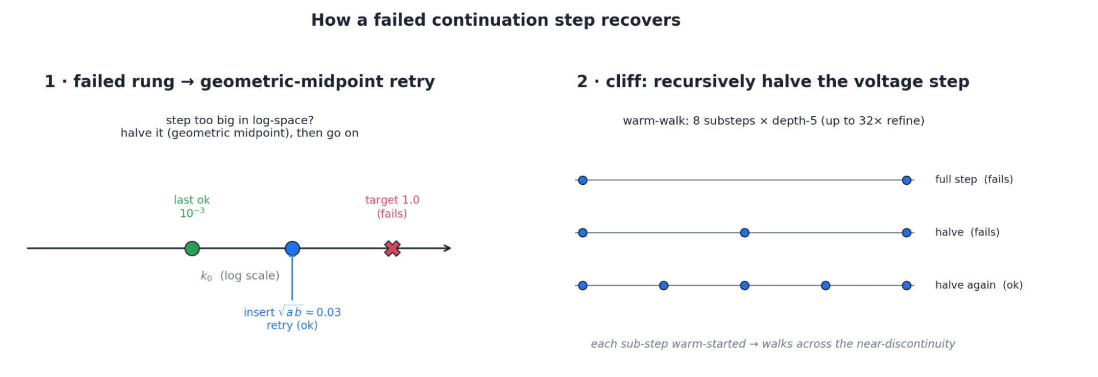

Slide 17
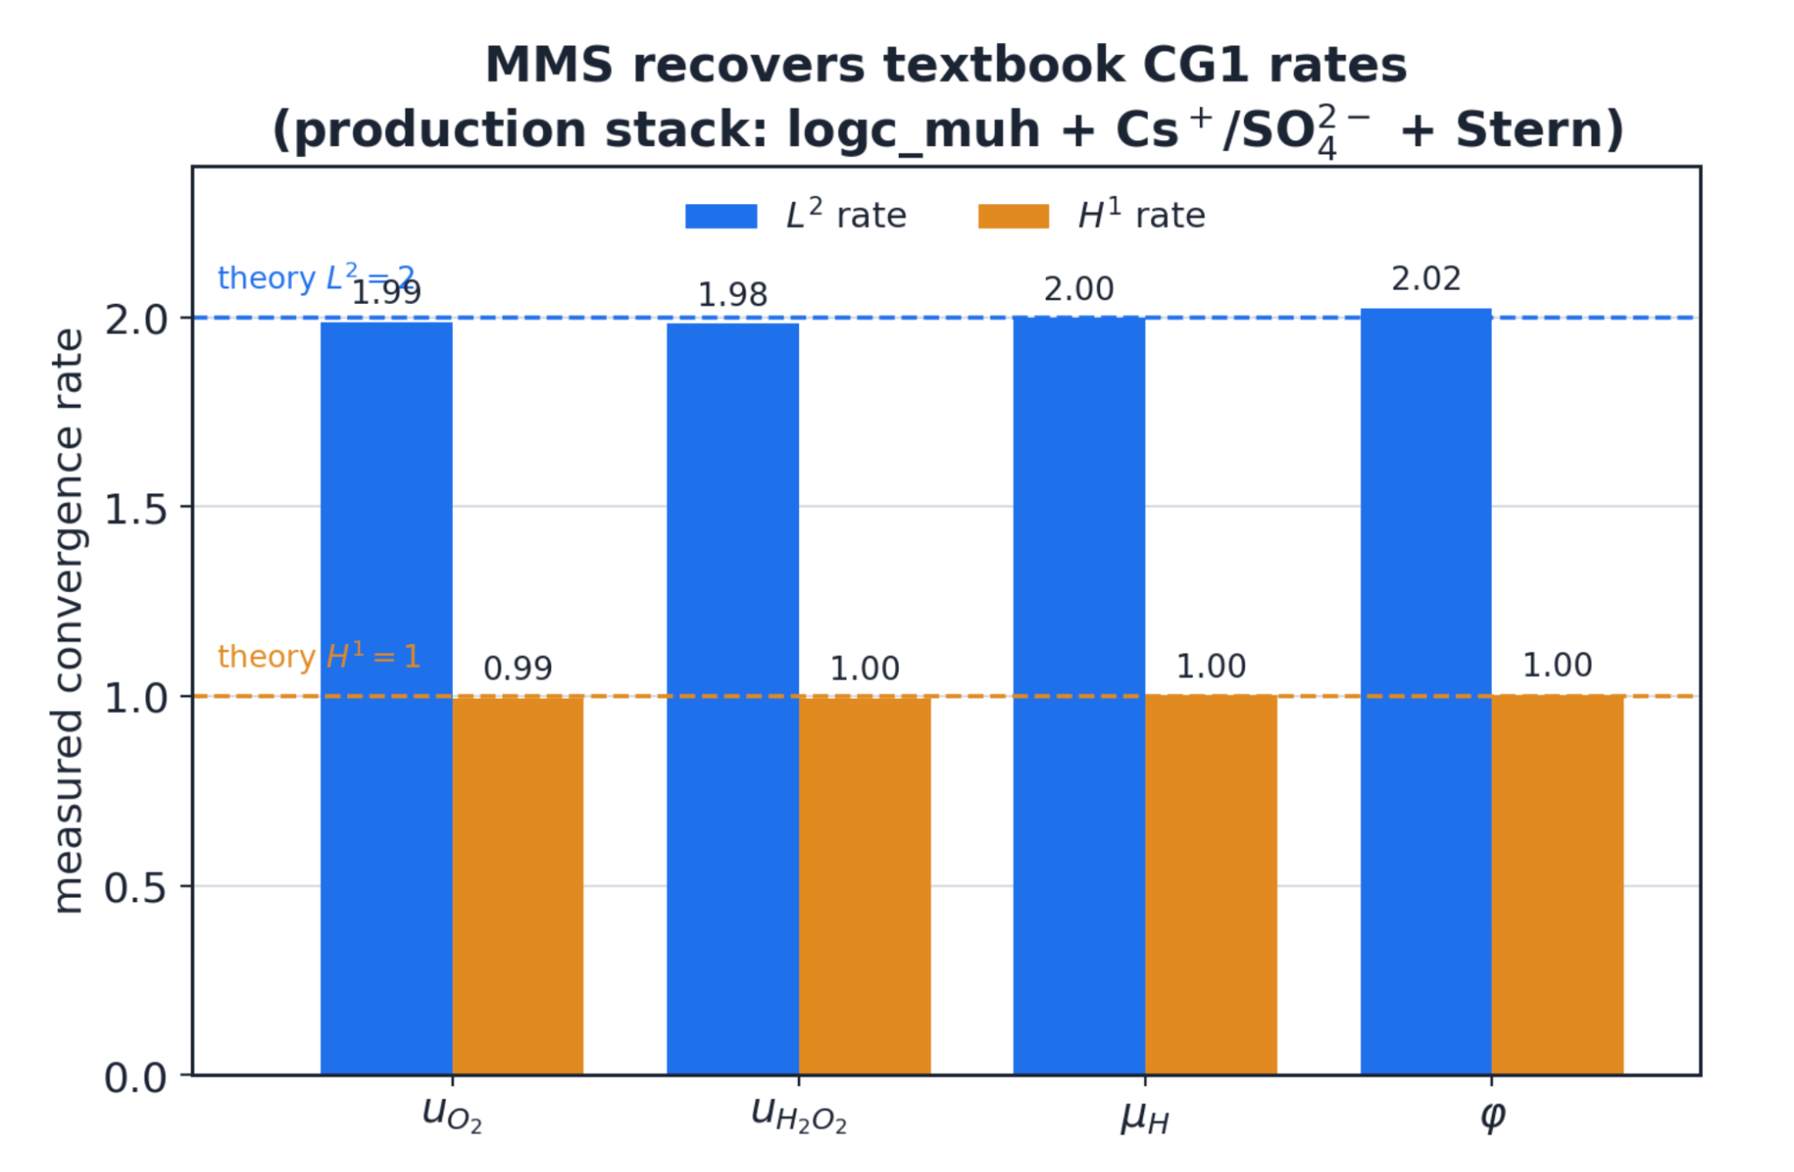
Verification: MMS

Slide 18
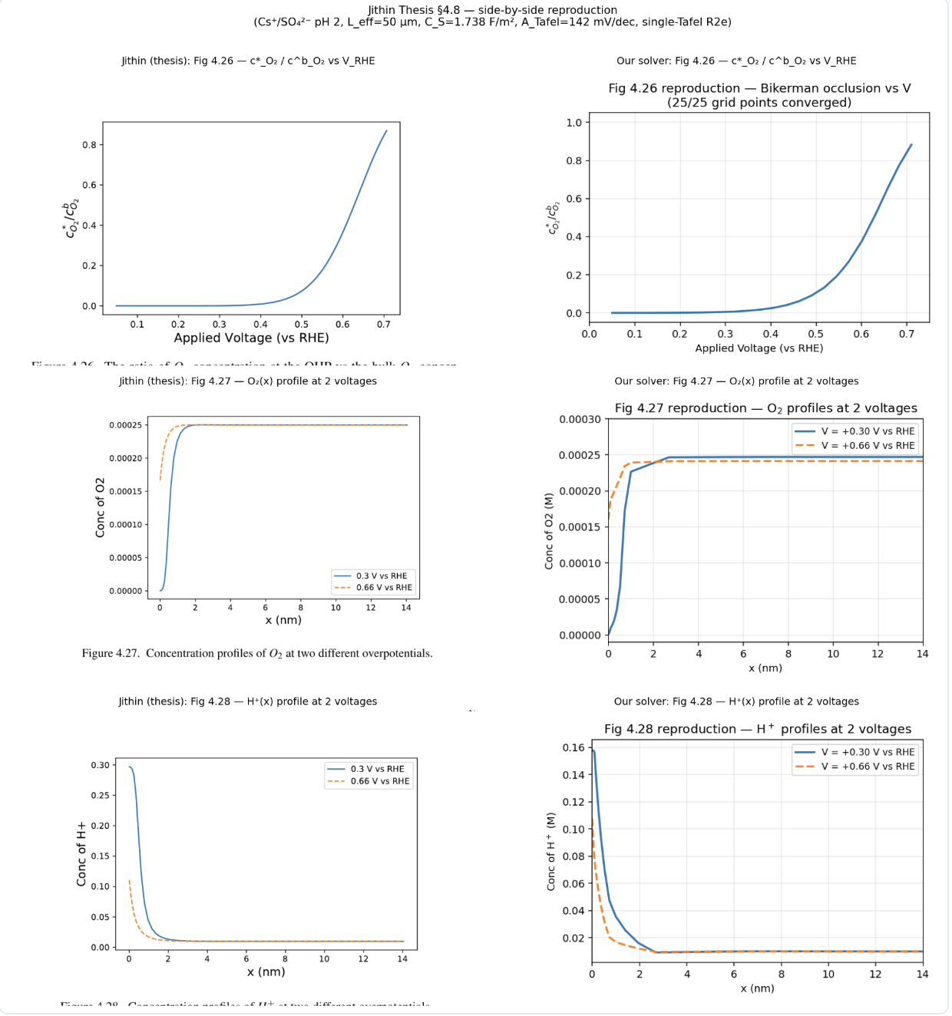
Verification: Agreement with previous work
List changes made to solver to emulate previous work.

Slide 19
What’s next?
Experimentation to find a better model for the system using this solver.

Slide 20
Tentative cation hydrolysis

